Slide 1
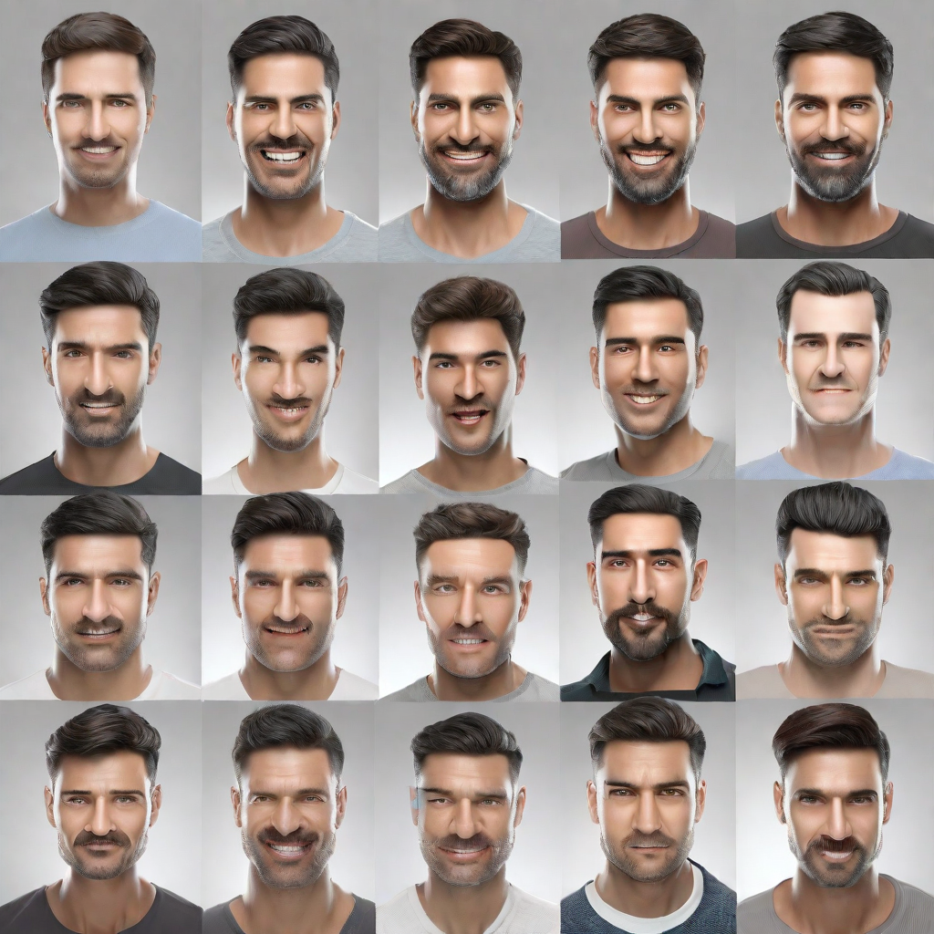
Facial Emotion Detection in Images: An Exploration using Computer Vision Techniques
Students Name :
Odai Thalji
Yousef Zeidan
Guided by:
Dr. Mohamed Almsedeen

Slide 2
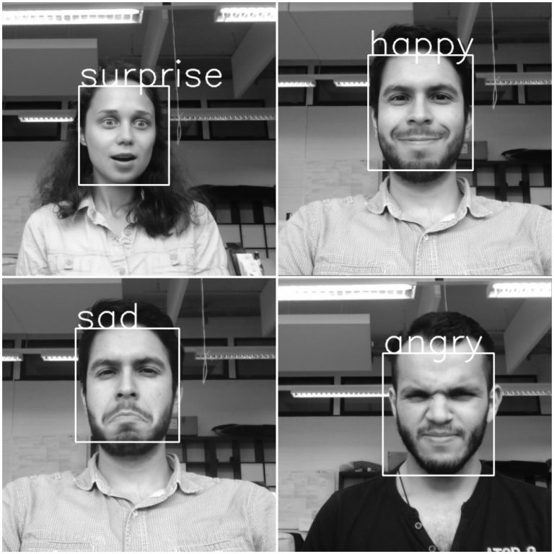
﻿Introduction
Facial emotion detection is a computer vision technique that involves analyzing facial expressions to determine the emotions being expressed by an individual.
By leveraging machine learning algorithms and deep neural networks, facial emotion detection models can accurately classify emotions such as happiness, sadness, anger, surprise, fear, and disgust. These models can analyze various facial features, including the position of the eyebrows, the shape of the mouth, and the intensity of the eyes, to make predictions about the emotional state of an individual.

Slide 3
Applications of Facial Emotion Detection
Market Research: Facial emotion detection can be used to gather valuable data on consumer reactions to products, advertisements, and user interfaces.
Healthcare: Facial emotion detection can assist in diagnosing and monitoring mental health conditions such as depression and anxiety.
Education: Facial emotion detection can be used in educational settings to assess student engagement and emotional responses to learning materials.
Security: Facial emotion detection can be employed in security systems to identify suspicious or threatening behavior.

Slide 4
Computer Vision Techniques
Feature Extraction: This technique involves extracting facial features such as eyes, eyebrows, nose, and mouth to analyze the subtle changes in their positions and shapes that indicate different emotions.
Machine Learning: Machine learning algorithms are trained on large datasets of labeled facial expressions to learn patterns and classify emotions accurately
Neural Networks: Neural networks, particularly convolutional neural networks (CNNs), are commonly used in facial emotion detection. CNNs can learn hierarchical representations of facial features, enabling accurate emotion classification.

Slide 5
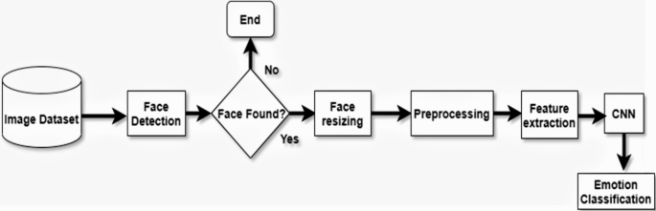
General view
Capture : take each frame from the live video
Face detection : Detect if there face or not
Face Extraction : extraction of the face's boundaries from the frames
Preprocessing : prepare the image to make a prediction
Emotion detection : assign each face to a specific emotion using a CNN model

Slide 6
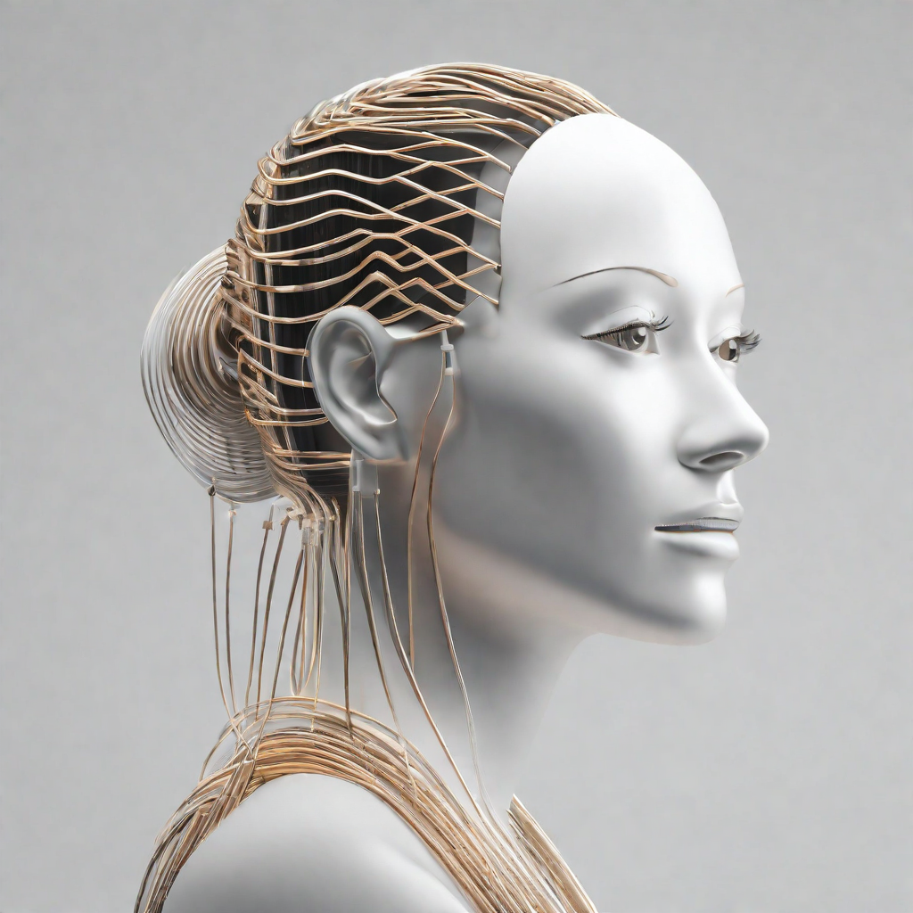

Data Collection and Preprocessing
Data Collection
To train a facial emotion detection model, a dataset of facial images with labeled emotions is required.
Preprocessing
involves cleaning the data, removing any irrelevant information, and standardizing the images to ensure consistent quality and format.

Slide 7
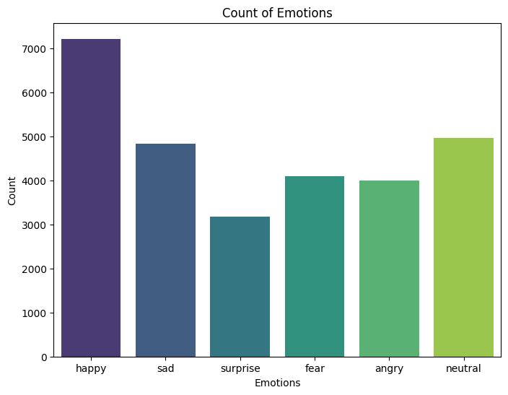
Data Collection
The FER2013 dataset is a collection of grayscale images depicting seven distinct facial expressions: anger, disgust, fear, happiness, sadness, surprise, and neutrality. Comprising around 35,000 images . Images were sourced from the internet to encompass various demographics and emotions displayed in diverse lighting and backgrounds.
fer2013 dataset

Slide 8
Data Preprocessing
Gray Scale
Resize image (48 * 48)
Data augmentation
Label encoder
feature extraction ( using cascade classifier )

Slide 9
Cascad
Classifier Cascade: The term "cascade" refers to a series of classifiers organized in a specific way to efficiently detect objects. The cascade is made up of stages where each stage contains a set of weak classifiers.
Object Detection: CascadeClassifier helps identify objects in images or video frames. It's commonly used for tasks like face detection, pedestrian detection, or detecting other objects like cars, animals, etc.
Pre-Trained Models: OpenCV provides pre-trained cascade classifiers for various tasks.
Usage: You can load a pre-trained cascade classifier using CascadeClassifier in your code, then apply it to images or video frames to detect objects. The classifier scans through the input using a sliding window approach, identifying potential regions containing the specified object.

Slide 10
CNN Architecture
Our CNN Architecture has 6 Hidden layer
4conv ,2FC
max booling and dropout
batch Normalization
Input Layer (shape ( 48 ,48 ,1 ) )
Cov2 (64 , 128 , 512,512)
FC ( 256 , 512 )
Output layer 6 class

Slide 11
Model Training and Evaluation
Data Collection
We collect a diverse dataset of facial images representing different emotions.
Preprocessing
The collected images are preprocessed to enhance facial features and remove noise.
Model Training
We train our facial emotion detection model using deep learning algorithms.
Model Evaluation
We evaluate the performance of our model using various metrics such as accuracy, precision, and recall.

Slide 12
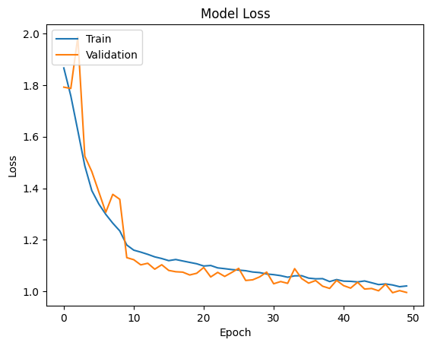
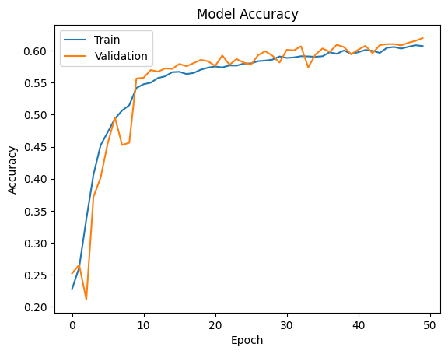
Results and Discussion

Slide 13
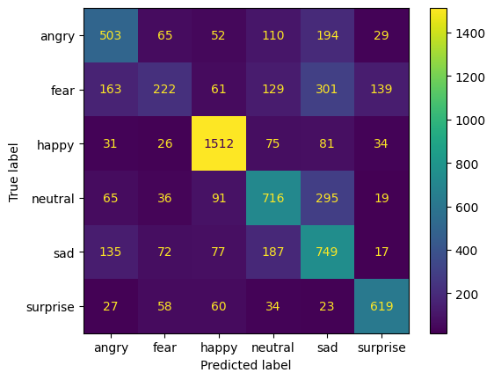
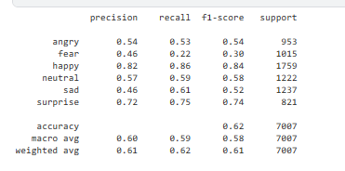
Results and Discussion

Slide 14
Conclusion
By leveraging computer vision algorithms and machine learning models, we have successfully developed a system capable of accurately detecting and classifying facial emotions.
This technology has the potential to revolutionize various industries, including marketing, healthcare, and entertainment, by enabling automated analysis of human emotions from images.
Furthermore, our exploration has highlighted the importance of ethical considerations in the development and deployment of facial emotion detection systems.
In summary, facial emotion detection using computer vision techniques holds great promise and potential, but it must be approached with care and responsibility.
Vision for the future :-
detect more details about face like gender , face ,age point etc..
Generated description for image
generated image based on text data

Slide 15
Related Work (References)
fer2013 (kaggle.com)
Facial expression detection using Machine Learning in Python | by Aaditya Singhal | Analytics Vidhya | Medium
Deep Face Recognition with VGG-Face in Keras | sefiks.com

Slide 16
questions/answering

